Slide 1
Accelerometer sleep state prediction
Lukas Johansson, Aurelio Negri

Slide 2
Index:
Recap
Timeline
Implementation
results
GUI
Product specification
Business plan
Difficulties we encountered

Slide 3
Project recap
Why sleep state prediction?
Product formfactor
User demographics

Slide 4
Project Timeline
Study
Explore
Present
Study other approaches and solutions.
Explore different models and approaches
Present the results in a report
S
L
E
E
P
Learn
Evaluate
Learn the data and apply feature augmentation/ selection.
Evaluate and fine tune, test in real world data (optional with APP)

Slide 5
Segmentation Approaches
1.1
2.1
2.3
1.2
2.2
2.4
Linear SVM
U-Time
MLP Mixer
Yields an accuracy of 82%
Based on U-Net, L1 Loss of 91
No need for Conv layers, L1 Loss of 102
Gradient Boosted Trees
DeepLab
Time2Vec
Improves to 92%
Based on DeepLabV3,
L1 Loss of 87
For feature extraction, L1 Loss of 110

Slide 6
Results
0.62
86%
AP-Metric results: Show an average of 10 minutes classification error
Correct fine-predictions on Test-Set

Slide 7
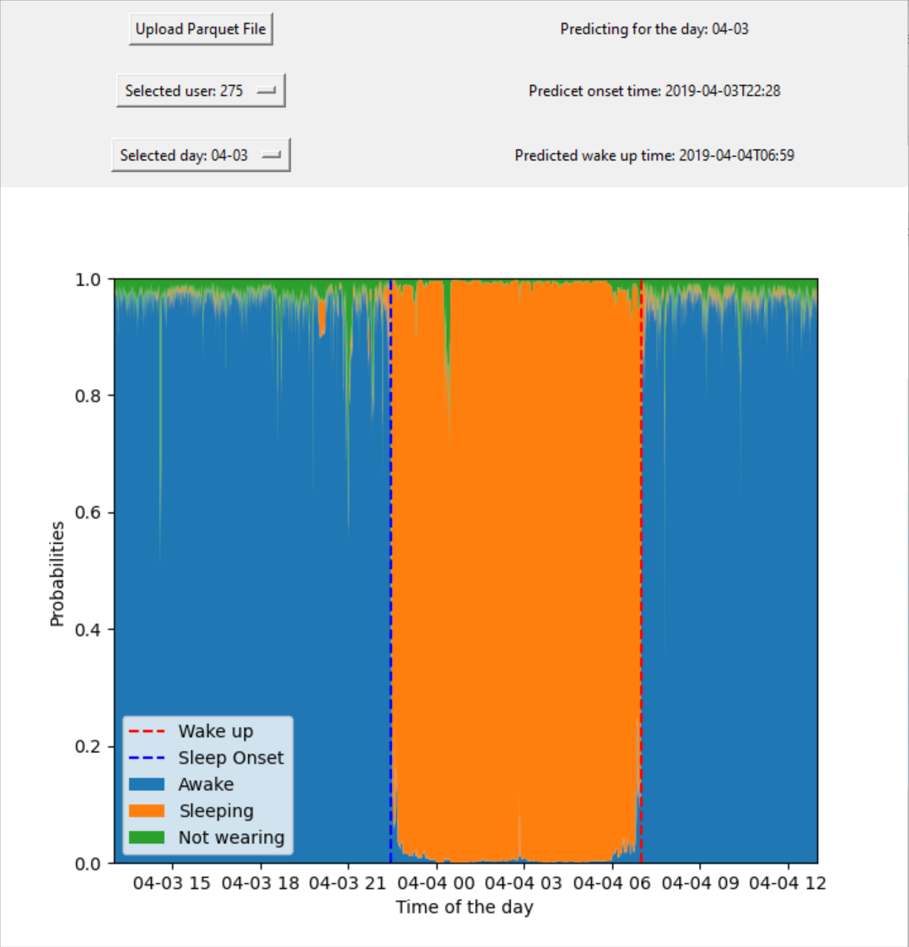
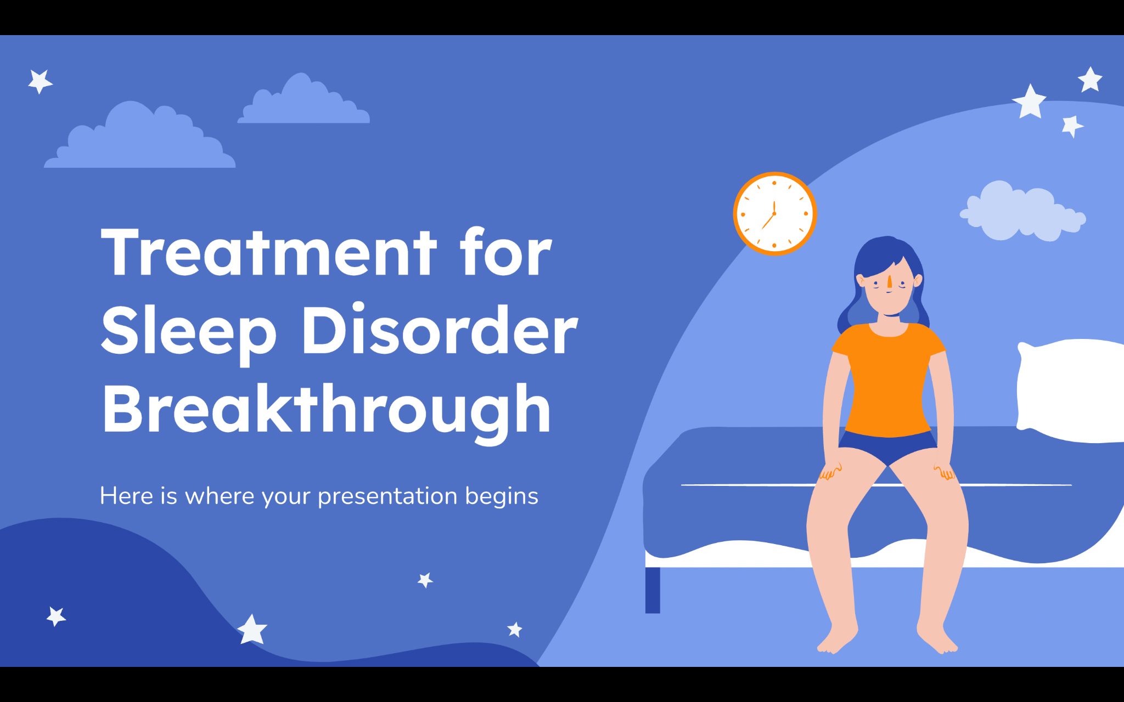
Application
Ease of use: Windows executable
Visualization of the predictions

Slide 8
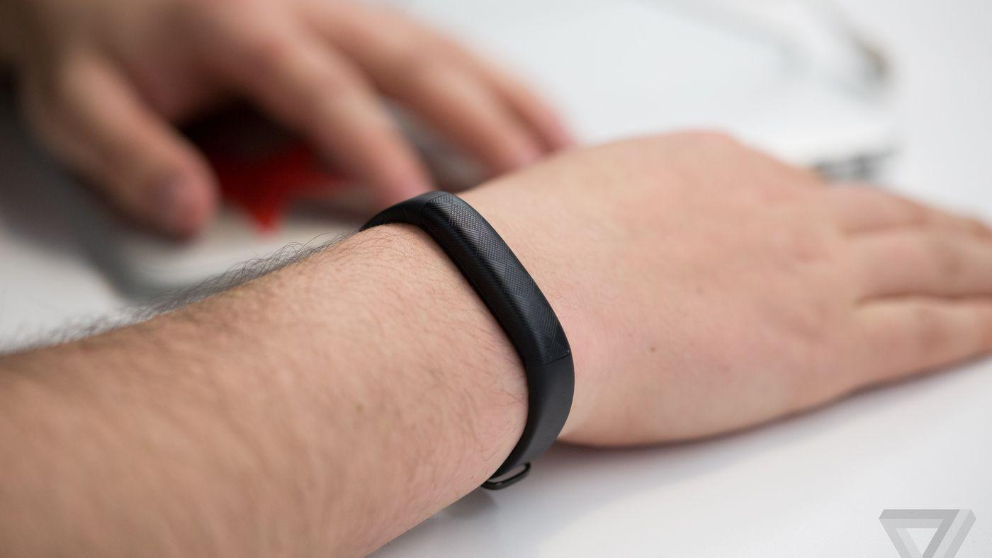
Wrist band
Product Requirements
Slim and light formfactor
5 MB storage
Bluetooth capability
Communicate battery charge
Minimum three days battery life
Affordable ~ 20 euro
Solution
100 mWh lithium battery ~ 12 €.
Integrated low energy bluetooth and microprocessor chip ~ 5 €.
Accelerometer, LED-diode, USB-C port, memory, casing … ~ 10 € in total.

Slide 9
Proposed Business Plan
Start with partnership
Past examples
Apple Heart Study in collaboration with Stanford Medicine
Fitbit and Bristol-Myers Squibb-Pfizer alliance
Technology Company
Medical research institute
Advantages
Publicity and credibility to Technology company
Publicity and credibility to product
Scientists can outsource product development
Can apply for research grants
Perform simultaneous product user tests
Quick to reach economies of scale
Large Scale Sleep
Research

Slide 10
Business Considerations
Interoperability standards
Regulation
Compliance
Funding opportunities
Comply with Interoperability standards such as HL7 FHIR and CONTINUA guidelines
Comply with medical device regulation such as GDPR and European CE certification
Set up project to be eligible of funding through organisations such as European Commission's Funding

Slide 11
Difficulties we encountered
Difficult to implement smart watch application.
Difficult to find optimal combination between size, battery duration and price.
Managing the large amount of data
Work with the unusual metric
Managing the large amount of code

Slide 12
Thanks!
Do you have any questions?
https://github.com/Aure20/SleepStatePrediction
Please keep this slide for attribution

